Slide 1

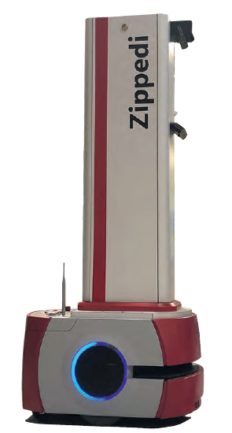
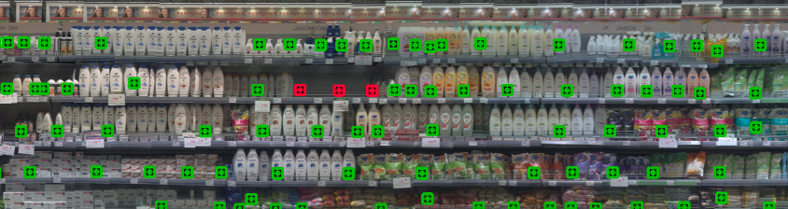
Robotics, IoT And Point Of Sales Data To Measure The Impact Of
Shelf Position On Sales
Andrés Musalem
Sofía Pontigo
Ariel Schilkrut
University of Chile
Zippedi

Slide 2
Motivation
Retail shelf space is a limited resource, where tens of thousands of products compete to capture the attention of customers.
To allocate this limited resource a retailer would benefit from knowing the impact of product position on sales.
Research efforts have been limited due to the high costs of conducting controlled experiments in stores and the low availability of shelf position data.
Recently, new technologies are allowing us to close this research gap.

Slide 3
Literature
Existing research:
  Observational studies (e.g., Frank and Massy 1970; Xu et al. 2025)
  => causal inference limitations
  Field experiments (e.g., Curhan 1972; Dreze et al. 1994; Cisternas 2023)
  => require retailer willingness to make multiple changes to planograms
  for sufficiently long periods; require planogram compliance
  Laboratory experiments (Chandon et al. 2009)
    => rely on digital representations of store shelves; external validity issues
  Ambulatory eyetracking (Chen et al. 2021)
    => focus on attention as opposed to sales/demand
Notes:
Desmet and renaudin:
A retail chain manager has to draw on experience based on data available from his points of sale to diagnose space misallocations in stores and to make recommendations. This paper presents an empirical estimate of shelf-space elasticities from a variety-store chain database at product category level with a share of space vs. share of sales econometric model. It suggests that external influences could explain space elasticity differences. Results show that space-elasticities increase with the impulse buying rate of the product category and do not depend on the type of store.
Existing research related to the impact of shelf position on sales can be classified into three main streams: observational
approaches (e.g., Frank and Massy 1970; Desmet and Renaudin 1998), field experiments (Curhan 1972; Dreze et al. 1994)
and laboratory experiments (e.g., Chandon et al. 2009). In terms of observational research, one of the rst examples of this
approach is given by Frank and Massy (1970), who study the role of vertical position on sales for three sizes of the seven
highest volume brands within a single product category. They used data from 30 stores which were manually collected via
store audits. The authors performed a cross-sectional analysis and concluded that shelf level has an extremely modest eect
on sales of this product, if any at all. Regarding eld experiments, Dreze et al. 1994 implemented planogram changes across 60
stores. One of the conclusions from this study is that vertical position changes lead to stronger changes in sales than horizontal
position modications. Finally, Chandon et al. (2009) use an eye-tracking laboratory experiment and nd that products in
top- and middle-shelf positions gain more attention than low-shelf positions; however, only top-shelf positions exhibit gains in
terms of brand evaluation.
Each of these three types of approaches has some limitations. Observational studies are typically not well suited to make
causal inferences (e.g., to verify whether shifting a product from the bottom to the top shelf leads to an increase in sales).
These methods instead can be quite eective at detecting correlations or associations instead of causal relationships between
variables. Field experiments require the retailer to agree to make changes to planograms for some products in some stores for
a suciently long period of time. Finally, laboratory experiments achieve high levels of internal validity but typically rely on
digital representations of physical shelves.
Furthermore, in the case of observational and eld experiment studies, the researcher needs access to shelf position data.
In prior empirical research this has been done by relying on planograms (e.g., Dreze et al. 1994) or physical audits (e.g.,Frank
and Massy 1970). Unfortunately, planograms are subject to compliance issues (Skorupa 2013). Indeed, in conversations
with practitioners, they indicate that planograms are changed with very low frequency (e.g., less often than once a year)
and that compliance decreases sharply after the rst weeks of implementing a new planogram. Regarding physical audits,
their implementation requires numerous labor hours, particularly if the study involves multiple stores, product categories and
periods and they are prone to coding errors.
Accordingly, this research will make four contributions to the literature. First, it proposes a methodology for the estimation
of the impact of product position on the performance of a product without the need of implementing experiments, and hence
taking advantage of data available to retailers and its providers. Second, from a substantive perspective, it will test and
validate hypotheses described in the next section about the impact of shelf position on sales that are motivated by vision
research and studies of shopping trajectories inside retail stores. Third, in contrast with previous studies, we will be able
to account for on-shelf stockouts when measuring the impact of product position on sales. Fourth, the substantive insights
from this research will be useful for other researchers interested in the development of algorithms for shelf space optimization.
These algorithms require knowledge of the relationship between shelf space and position on product demand.

Slide 4
This paper
Uses a new data capture technology (robotics, IoT, image processing) combined with a quasi-experimental approach to estimate the effect of shelf position changes on sales.
Notes:
Existing research related to the impact of shelf position on sales can be classified into three main streams: observational
approaches (e.g., Frank and Massy 1970; Desmet and Renaudin 1998), eld experiments (Curhan 1972; Dreze et al. 1994)
and laboratory experiments (e.g., Chandon et al. 2009). In terms of observational research, one of the rst examples of this
approach is given by Frank and Massy (1970), who study the role of vertical position on sales for three sizes of the seven
highest volume brands within a single product category. They used data from 30 stores which were manually collected via
store audits. The authors performed a cross-sectional analysis and concluded that shelf level has an extremely modest eect
on sales of this product, if any at all. Regarding eld experiments, Dreze et al. 1994 implemented planogram changes across 60
stores. One of the conclusions from this study is that vertical position changes lead to stronger changes in sales than horizontal
position modications. Finally, Chandon et al. (2009) use an eye-tracking laboratory experiment and nd that products in
top- and middle-shelf positions gain more attention than low-shelf positions; however, only top-shelf positions exhibit gains in
terms of brand evaluation.
Each of these three types of approaches has some limitations. Observational studies are typically not well suited to make
causal inferences (e.g., to verify whether shifting a product from the bottom to the top shelf leads to an increase in sales).
These methods instead can be quite eective at detecting correlations or associations instead of causal relationships between
variables. Field experiments require the retailer to agree to make changes to planograms for some products in some stores for
a suciently long period of time. Finally, laboratory experiments achieve high levels of internal validity but typically rely on
digital representations of physical shelves.
Furthermore, in the case of observational and eld experiment studies, the researcher needs access to shelf position data.
In prior empirical research this has been done by relying on planograms (e.g., Dreze et al. 1994) or physical audits (e.g.,Frank
and Massy 1970). Unfortunately, planograms are subject to compliance issues (Skorupa 2013). Indeed, in conversations
with practitioners, they indicate that planograms are changed with very low frequency (e.g., less often than once a year)
and that compliance decreases sharply after the rst weeks of implementing a new planogram. Regarding physical audits,
their implementation requires numerous labor hours, particularly if the study involves multiple stores, product categories and
periods and they are prone to coding errors.
Accordingly, this research will make four contributions to the literature. First, it proposes a methodology for the estimation
of the impact of product position on the performance of a product without the need of implementing experiments, and hence
taking advantage of data available to retailers and its providers. Second, from a substantive perspective, it will test and
validate hypotheses described in the next section about the impact of shelf position on sales that are motivated by vision
research and studies of shopping trajectories inside retail stores. Third, in contrast with previous studies, we will be able
to account for on-shelf stockouts when measuring the impact of product position on sales. Fourth, the substantive insights
from this research will be useful for other researchers interested in the development of algorithms for shelf space optimization.
These algorithms require knowledge of the relationship between shelf space and position on product demand.

Slide 5
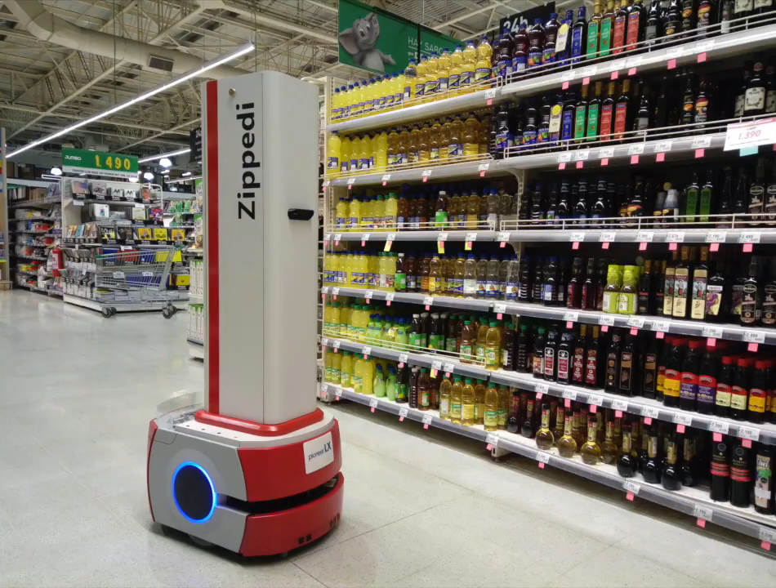
Zippedi data
The Zippedi Robot
Stockouts
On-shelf
availability
Improve
Missing price tags
Price integrity
Product location
Planogram compliance

Slide 6
Product Location
Photographed shelf

Slide 7
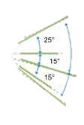

Hypotheses: Vertical
Related research:
  Hendrickson and Ailawadi (2014): natural gaze span is about 60 degrees long; consumers comfortably look at objects 25 degrees above and 35 degrees below eye level
  Chen et al. (2021): using an ambulatory eye-tracking experiment show that products that receive the greatest attention are those at the chest (rather than eye) level.
  H1 - Vertical Center: Products placed at heights right below the eye level achieve greater sales than if they were placed at other heights.
  H2 - Bottom versus top vertical positions: For shelves of a typical height (i.e., at least 2 meters or 6.5 feet), products placed at the lowest level of a shelf achieve greater sales than if they were placed at the highest level.
Notes:
Existing research related to the impact of shelf position on sales can be classified into three main streams: observational
approaches (e.g., Frank and Massy 1970; Desmet and Renaudin 1998), eld experiments (Curhan 1972; Dreze et al. 1994)
and laboratory experiments (e.g., Chandon et al. 2009). In terms of observational research, one of the rst examples of this
approach is given by Frank and Massy (1970), who study the role of vertical position on sales for three sizes of the seven
highest volume brands within a single product category. They used data from 30 stores which were manually collected via
store audits. The authors performed a cross-sectional analysis and concluded that shelf level has an extremely modest eect
on sales of this product, if any at all. Regarding eld experiments, Dreze et al. 1994 implemented planogram changes across 60
stores. One of the conclusions from this study is that vertical position changes lead to stronger changes in sales than horizontal
position modications. Finally, Chandon et al. (2009) use an eye-tracking laboratory experiment and nd that products in
top- and middle-shelf positions gain more attention than low-shelf positions; however, only top-shelf positions exhibit gains in
terms of brand evaluation.
Each of these three types of approaches has some limitations. Observational studies are typically not well suited to make
causal inferences (e.g., to verify whether shifting a product from the bottom to the top shelf leads to an increase in sales).
These methods instead can be quite eective at detecting correlations or associations instead of causal relationships between
variables. Field experiments require the retailer to agree to make changes to planograms for some products in some stores for
a suciently long period of time. Finally, laboratory experiments achieve high levels of internal validity but typically rely on
digital representations of physical shelves.
Furthermore, in the case of observational and eld experiment studies, the researcher needs access to shelf position data.
In prior empirical research this has been done by relying on planograms (e.g., Dreze et al. 1994) or physical audits (e.g.,Frank
and Massy 1970). Unfortunately, planograms are subject to compliance issues (Skorupa 2013). Indeed, in conversations
with practitioners, they indicate that planograms are changed with very low frequency (e.g., less often than once a year)
and that compliance decreases sharply after the rst weeks of implementing a new planogram. Regarding physical audits,
their implementation requires numerous labor hours, particularly if the study involves multiple stores, product categories and
periods and they are prone to coding errors.
Accordingly, this research will make four contributions to the literature. First, it proposes a methodology for the estimation
of the impact of product position on the performance of a product without the need of implementing experiments, and hence
taking advantage of data available to retailers and its providers. Second, from a substantive perspective, it will test and
validate hypotheses described in the next section about the impact of shelf position on sales that are motivated by vision
research and studies of shopping trajectories inside retail stores. Third, in contrast with previous studies, we will be able
to account for on-shelf stockouts when measuring the impact of product position on sales. Fourth, the substantive insights
from this research will be useful for other researchers interested in the development of algorithms for shelf space optimization.
These algorithms require knowledge of the relationship between shelf space and position on product demand.

Slide 8
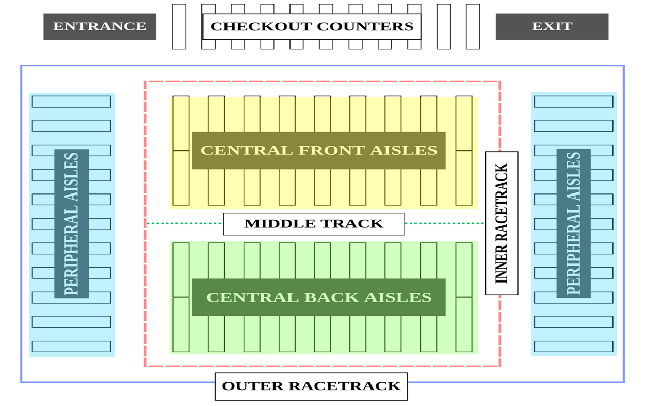
Hypotheses: Horizontal
Related research:
  Hui and Bradlow (2012): only visit about one-third of the store.
  Larson et al. (2005): customers travel primarily through the racetrack (the outer ring of the store) and perform short visits into the aisles.
  H3 - Horizontal position: Products placed near the racetrack will achieve greater sales.
  Remarks: Some supermarkets of a larger size have a high traffic middle track. Also, they have a peripheral section. It is a priori unclear if this section falls inside or outside the racetrack. Our analysis is agnostic about this definition.
Notes:
Existing research related to the impact of shelf position on sales can be classified into three main streams: observational
approaches (e.g., Frank and Massy 1970; Desmet and Renaudin 1998), eld experiments (Curhan 1972; Dreze et al. 1994)
and laboratory experiments (e.g., Chandon et al. 2009). In terms of observational research, one of the rst examples of this
approach is given by Frank and Massy (1970), who study the role of vertical position on sales for three sizes of the seven
highest volume brands within a single product category. They used data from 30 stores which were manually collected via
store audits. The authors performed a cross-sectional analysis and concluded that shelf level has an extremely modest eect
on sales of this product, if any at all. Regarding eld experiments, Dreze et al. 1994 implemented planogram changes across 60
stores. One of the conclusions from this study is that vertical position changes lead to stronger changes in sales than horizontal
position modications. Finally, Chandon et al. (2009) use an eye-tracking laboratory experiment and nd that products in
top- and middle-shelf positions gain more attention than low-shelf positions; however, only top-shelf positions exhibit gains in
terms of brand evaluation.
Each of these three types of approaches has some limitations. Observational studies are typically not well suited to make
causal inferences (e.g., to verify whether shifting a product from the bottom to the top shelf leads to an increase in sales).
These methods instead can be quite eective at detecting correlations or associations instead of causal relationships between
variables. Field experiments require the retailer to agree to make changes to planograms for some products in some stores for
a suciently long period of time. Finally, laboratory experiments achieve high levels of internal validity but typically rely on
digital representations of physical shelves.
Furthermore, in the case of observational and eld experiment studies, the researcher needs access to shelf position data.
In prior empirical research this has been done by relying on planograms (e.g., Dreze et al. 1994) or physical audits (e.g.,Frank
and Massy 1970). Unfortunately, planograms are subject to compliance issues (Skorupa 2013). Indeed, in conversations
with practitioners, they indicate that planograms are changed with very low frequency (e.g., less often than once a year)
and that compliance decreases sharply after the rst weeks of implementing a new planogram. Regarding physical audits,
their implementation requires numerous labor hours, particularly if the study involves multiple stores, product categories and
periods and they are prone to coding errors.
Accordingly, this research will make four contributions to the literature. First, it proposes a methodology for the estimation
of the impact of product position on the performance of a product without the need of implementing experiments, and hence
taking advantage of data available to retailers and its providers. Second, from a substantive perspective, it will test and
validate hypotheses described in the next section about the impact of shelf position on sales that are motivated by vision
research and studies of shopping trajectories inside retail stores. Third, in contrast with previous studies, we will be able
to account for on-shelf stockouts when measuring the impact of product position on sales. Fourth, the substantive insights
from this research will be useful for other researchers interested in the development of algorithms for shelf space optimization.
These algorithms require knowledge of the relationship between shelf space and position on product demand.

Slide 9
Hypotheses: Horizontal
Related research:
  Chandon et al. (2009) suggest that placing a brand near the horizontal center of a shelf (rather than on either of its ends) increases attention and choice.
  H4a - Horizontal position: Products placed in the middle of an aisle will achieve greater sales than those near the ends of an aisle.
Notes:
Existing research related to the impact of shelf position on sales can be classified into three main streams: observational
approaches (e.g., Frank and Massy 1970; Desmet and Renaudin 1998), eld experiments (Curhan 1972; Dreze et al. 1994)
and laboratory experiments (e.g., Chandon et al. 2009). In terms of observational research, one of the rst examples of this
approach is given by Frank and Massy (1970), who study the role of vertical position on sales for three sizes of the seven
highest volume brands within a single product category. They used data from 30 stores which were manually collected via
store audits. The authors performed a cross-sectional analysis and concluded that shelf level has an extremely modest eect
on sales of this product, if any at all. Regarding eld experiments, Dreze et al. 1994 implemented planogram changes across 60
stores. One of the conclusions from this study is that vertical position changes lead to stronger changes in sales than horizontal
position modications. Finally, Chandon et al. (2009) use an eye-tracking laboratory experiment and nd that products in
top- and middle-shelf positions gain more attention than low-shelf positions; however, only top-shelf positions exhibit gains in
terms of brand evaluation.
Each of these three types of approaches has some limitations. Observational studies are typically not well suited to make
causal inferences (e.g., to verify whether shifting a product from the bottom to the top shelf leads to an increase in sales).
These methods instead can be quite eective at detecting correlations or associations instead of causal relationships between
variables. Field experiments require the retailer to agree to make changes to planograms for some products in some stores for
a suciently long period of time. Finally, laboratory experiments achieve high levels of internal validity but typically rely on
digital representations of physical shelves.
Furthermore, in the case of observational and eld experiment studies, the researcher needs access to shelf position data.
In prior empirical research this has been done by relying on planograms (e.g., Dreze et al. 1994) or physical audits (e.g.,Frank
and Massy 1970). Unfortunately, planograms are subject to compliance issues (Skorupa 2013). Indeed, in conversations
with practitioners, they indicate that planograms are changed with very low frequency (e.g., less often than once a year)
and that compliance decreases sharply after the rst weeks of implementing a new planogram. Regarding physical audits,
their implementation requires numerous labor hours, particularly if the study involves multiple stores, product categories and
periods and they are prone to coding errors.
Accordingly, this research will make four contributions to the literature. First, it proposes a methodology for the estimation
of the impact of product position on the performance of a product without the need of implementing experiments, and hence
taking advantage of data available to retailers and its providers. Second, from a substantive perspective, it will test and
validate hypotheses described in the next section about the impact of shelf position on sales that are motivated by vision
research and studies of shopping trajectories inside retail stores. Third, in contrast with previous studies, we will be able
to account for on-shelf stockouts when measuring the impact of product position on sales. Fourth, the substantive insights
from this research will be useful for other researchers interested in the development of algorithms for shelf space optimization.
These algorithms require knowledge of the relationship between shelf space and position on product demand.

Slide 10
Hypotheses: Horizontal
Related research:
  Meissner et al. (2016) central choice alternatives in conjoint studies receive more attention but do not exhibit greater choice probabilities.
  H4b - Horizontal position: Products placed in the middle of an aisle will not achieve greater sales than those near the ends of an aisle.
Notes:
Existing research related to the impact of shelf position on sales can be classified into three main streams: observational
approaches (e.g., Frank and Massy 1970; Desmet and Renaudin 1998), eld experiments (Curhan 1972; Dreze et al. 1994)
and laboratory experiments (e.g., Chandon et al. 2009). In terms of observational research, one of the rst examples of this
approach is given by Frank and Massy (1970), who study the role of vertical position on sales for three sizes of the seven
highest volume brands within a single product category. They used data from 30 stores which were manually collected via
store audits. The authors performed a cross-sectional analysis and concluded that shelf level has an extremely modest eect
on sales of this product, if any at all. Regarding eld experiments, Dreze et al. 1994 implemented planogram changes across 60
stores. One of the conclusions from this study is that vertical position changes lead to stronger changes in sales than horizontal
position modications. Finally, Chandon et al. (2009) use an eye-tracking laboratory experiment and nd that products in
top- and middle-shelf positions gain more attention than low-shelf positions; however, only top-shelf positions exhibit gains in
terms of brand evaluation.
Each of these three types of approaches has some limitations. Observational studies are typically not well suited to make
causal inferences (e.g., to verify whether shifting a product from the bottom to the top shelf leads to an increase in sales).
These methods instead can be quite eective at detecting correlations or associations instead of causal relationships between
variables. Field experiments require the retailer to agree to make changes to planograms for some products in some stores for
a suciently long period of time. Finally, laboratory experiments achieve high levels of internal validity but typically rely on
digital representations of physical shelves.
Furthermore, in the case of observational and eld experiment studies, the researcher needs access to shelf position data.
In prior empirical research this has been done by relying on planograms (e.g., Dreze et al. 1994) or physical audits (e.g.,Frank
and Massy 1970). Unfortunately, planograms are subject to compliance issues (Skorupa 2013). Indeed, in conversations
with practitioners, they indicate that planograms are changed with very low frequency (e.g., less often than once a year)
and that compliance decreases sharply after the rst weeks of implementing a new planogram. Regarding physical audits,
their implementation requires numerous labor hours, particularly if the study involves multiple stores, product categories and
periods and they are prone to coding errors.
Accordingly, this research will make four contributions to the literature. First, it proposes a methodology for the estimation
of the impact of product position on the performance of a product without the need of implementing experiments, and hence
taking advantage of data available to retailers and its providers. Second, from a substantive perspective, it will test and
validate hypotheses described in the next section about the impact of shelf position on sales that are motivated by vision
research and studies of shopping trajectories inside retail stores. Third, in contrast with previous studies, we will be able
to account for on-shelf stockouts when measuring the impact of product position on sales. Fourth, the substantive insights
from this research will be useful for other researchers interested in the development of algorithms for shelf space optimization.
These algorithms require knowledge of the relationship between shelf space and position on product demand.

Slide 11
Hypotheses: Horizontal vs. Vertical
Related research:
  Hendrickson and Ailawadi (2014): Vision research suggests that consumers are more likely to inspect information from left to right and then from top to bottom => placing a product at the best vertical level seems more important than its horizontal placement along the length of an aisle.
  Dreze et al. 1994: vertical effects were found to be stronger than horizontal effects.
  H5 - Vertical vs. horizontal position effects: The impact of vertical position on the sales of a product is expected to be stronger than that of horizontal position.
Notes:
Existing research related to the impact of shelf position on sales can be classified into three main streams: observational
approaches (e.g., Frank and Massy 1970; Desmet and Renaudin 1998), eld experiments (Curhan 1972; Dreze et al. 1994)
and laboratory experiments (e.g., Chandon et al. 2009). In terms of observational research, one of the rst examples of this
approach is given by Frank and Massy (1970), who study the role of vertical position on sales for three sizes of the seven
highest volume brands within a single product category. They used data from 30 stores which were manually collected via
store audits. The authors performed a cross-sectional analysis and concluded that shelf level has an extremely modest eect
on sales of this product, if any at all. Regarding eld experiments, Dreze et al. 1994 implemented planogram changes across 60
stores. One of the conclusions from this study is that vertical position changes lead to stronger changes in sales than horizontal
position modications. Finally, Chandon et al. (2009) use an eye-tracking laboratory experiment and nd that products in
top- and middle-shelf positions gain more attention than low-shelf positions; however, only top-shelf positions exhibit gains in
terms of brand evaluation.
Each of these three types of approaches has some limitations. Observational studies are typically not well suited to make
causal inferences (e.g., to verify whether shifting a product from the bottom to the top shelf leads to an increase in sales).
These methods instead can be quite eective at detecting correlations or associations instead of causal relationships between
variables. Field experiments require the retailer to agree to make changes to planograms for some products in some stores for
a suciently long period of time. Finally, laboratory experiments achieve high levels of internal validity but typically rely on
digital representations of physical shelves.
Furthermore, in the case of observational and eld experiment studies, the researcher needs access to shelf position data.
In prior empirical research this has been done by relying on planograms (e.g., Dreze et al. 1994) or physical audits (e.g.,Frank
and Massy 1970). Unfortunately, planograms are subject to compliance issues (Skorupa 2013). Indeed, in conversations
with practitioners, they indicate that planograms are changed with very low frequency (e.g., less often than once a year)
and that compliance decreases sharply after the rst weeks of implementing a new planogram. Regarding physical audits,
their implementation requires numerous labor hours, particularly if the study involves multiple stores, product categories and
periods and they are prone to coding errors.
Accordingly, this research will make four contributions to the literature. First, it proposes a methodology for the estimation
of the impact of product position on the performance of a product without the need of implementing experiments, and hence
taking advantage of data available to retailers and its providers. Second, from a substantive perspective, it will test and
validate hypotheses described in the next section about the impact of shelf position on sales that are motivated by vision
research and studies of shopping trajectories inside retail stores. Third, in contrast with previous studies, we will be able
to account for on-shelf stockouts when measuring the impact of product position on sales. Fourth, the substantive insights
from this research will be useful for other researchers interested in the development of algorithms for shelf space optimization.
These algorithms require knowledge of the relationship between shelf space and position on product demand.

Slide 12
Hypotheses: Strategic Allocation
Endogeneity & Strategic Allocation:
  Retailers decide which products will occupy each position on the shelf. For example, retailers could choose to place high demand products in the middle of an aisle to get consumers exposed to other products.
  H6 - Endogeneity: Ignoring the strategic assignment of products to shelf positions would bias the value of certain shelf positions.
Notes:
Existing research related to the impact of shelf position on sales can be classified into three main streams: observational
approaches (e.g., Frank and Massy 1970; Desmet and Renaudin 1998), eld experiments (Curhan 1972; Dreze et al. 1994)
and laboratory experiments (e.g., Chandon et al. 2009). In terms of observational research, one of the rst examples of this
approach is given by Frank and Massy (1970), who study the role of vertical position on sales for three sizes of the seven
highest volume brands within a single product category. They used data from 30 stores which were manually collected via
store audits. The authors performed a cross-sectional analysis and concluded that shelf level has an extremely modest eect
on sales of this product, if any at all. Regarding eld experiments, Dreze et al. 1994 implemented planogram changes across 60
stores. One of the conclusions from this study is that vertical position changes lead to stronger changes in sales than horizontal
position modications. Finally, Chandon et al. (2009) use an eye-tracking laboratory experiment and nd that products in
top- and middle-shelf positions gain more attention than low-shelf positions; however, only top-shelf positions exhibit gains in
terms of brand evaluation.
Each of these three types of approaches has some limitations. Observational studies are typically not well suited to make
causal inferences (e.g., to verify whether shifting a product from the bottom to the top shelf leads to an increase in sales).
These methods instead can be quite eective at detecting correlations or associations instead of causal relationships between
variables. Field experiments require the retailer to agree to make changes to planograms for some products in some stores for
a suciently long period of time. Finally, laboratory experiments achieve high levels of internal validity but typically rely on
digital representations of physical shelves.
Furthermore, in the case of observational and eld experiment studies, the researcher needs access to shelf position data.
In prior empirical research this has been done by relying on planograms (e.g., Dreze et al. 1994) or physical audits (e.g.,Frank
and Massy 1970). Unfortunately, planograms are subject to compliance issues (Skorupa 2013). Indeed, in conversations
with practitioners, they indicate that planograms are changed with very low frequency (e.g., less often than once a year)
and that compliance decreases sharply after the rst weeks of implementing a new planogram. Regarding physical audits,
their implementation requires numerous labor hours, particularly if the study involves multiple stores, product categories and
periods and they are prone to coding errors.
Accordingly, this research will make four contributions to the literature. First, it proposes a methodology for the estimation
of the impact of product position on the performance of a product without the need of implementing experiments, and hence
taking advantage of data available to retailers and its providers. Second, from a substantive perspective, it will test and
validate hypotheses described in the next section about the impact of shelf position on sales that are motivated by vision
research and studies of shopping trajectories inside retail stores. Third, in contrast with previous studies, we will be able
to account for on-shelf stockouts when measuring the impact of product position on sales. Fourth, the substantive insights
from this research will be useful for other researchers interested in the development of algorithms for shelf space optimization.
These algorithms require knowledge of the relationship between shelf space and position on product demand.

Slide 13
Our data
The data set considers sales, prices, stockouts and product position data for:
  13 stores of a major supermarket chain in Latin America
  One of the retailer’s vendors covering 704 products across five product categories (personal care, cleaners, sauces and dressings, general grocery and dairy).
  Period: May 11th 2020 - October 31, 2021.
  Caveat: endcaps not covered to allow robot to scan all aisles during a single night.

Slide 14
Aisle Clasification

Slide 15
Our approach
Using this data set, we performe two analyses:
  A descriptive analysis to explore possible (non-causal) associations between product position and sales.
  A quasi-experimental analysis to draw causal inferences about the impact of shelf position on sales.

Slide 16
Descriptive analysis
Dependent variable: sales_{ist}
Predictors:
  Position:
    Vertical position: distance from bottom shelf, distance from vertical center
    Horizontal position: distance from origin, distance from horizontal center
    Location of the product’s aisle within the store (e.g., central front, central back vs. peripheral)
  Controls: Store, Category, Price, Month of the year, Day of the week.
Models: Poisson, NBD regression
period
product
store

Slide 17
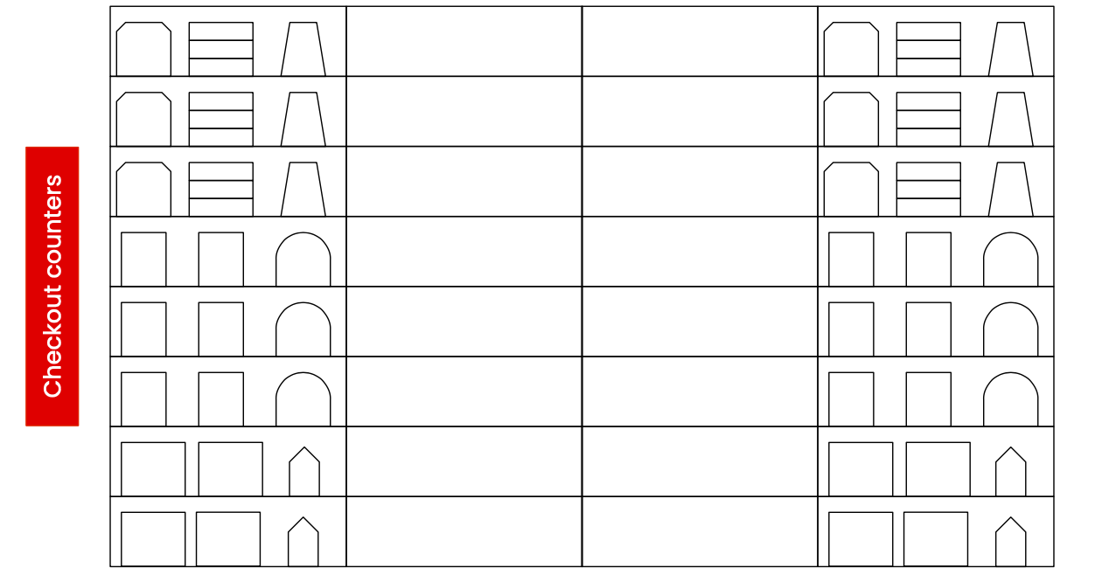
Horizontal/Vertical Distance
Horizontal Origin: defined as closest to racetrack
0

Slide 18
Distance from Center
0
0

Slide 19
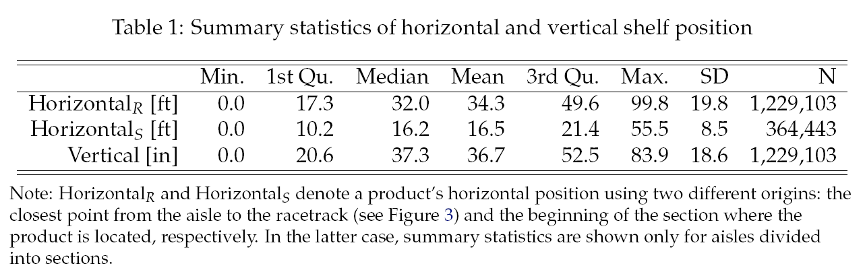
Summary Statistics (in feet)
10.5 meters
0.93 meters
Notes:
231 unique products

Slide 20
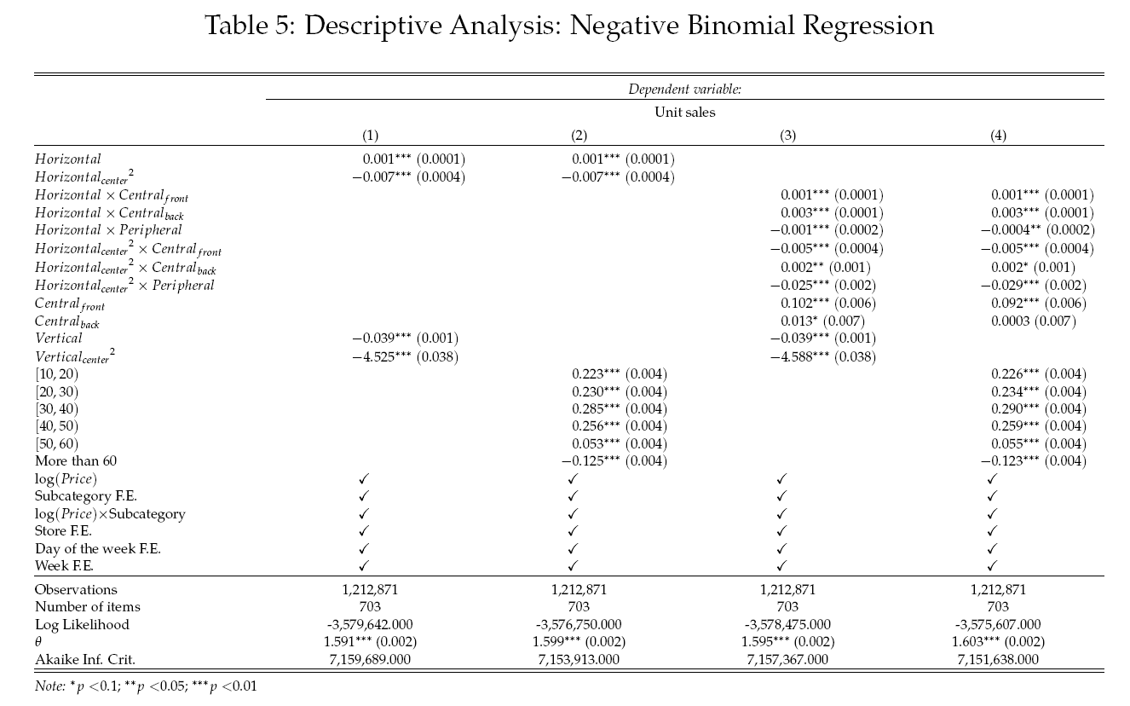
Results: Neg. Bin. regression

Slide 21
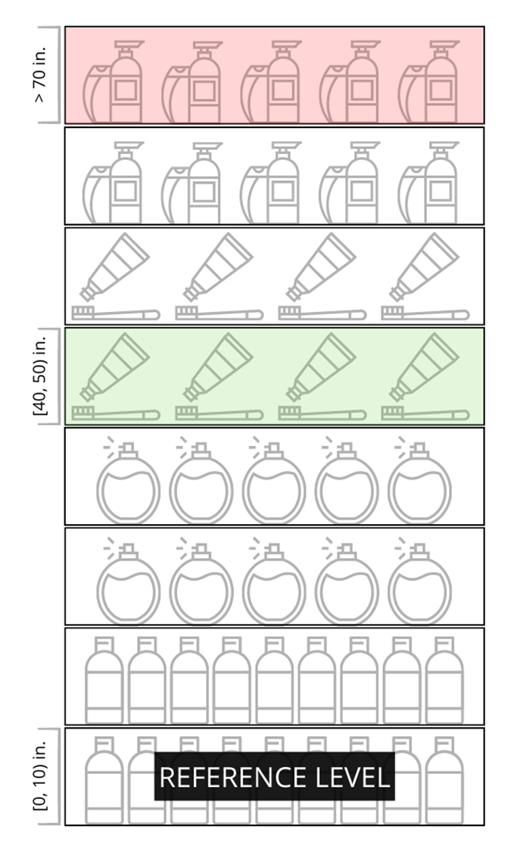

Sales and Vertical Position
-12%
+6%
+30%
0.75 - 1.0 meters
+34%
+26%
+25%

Slide 22
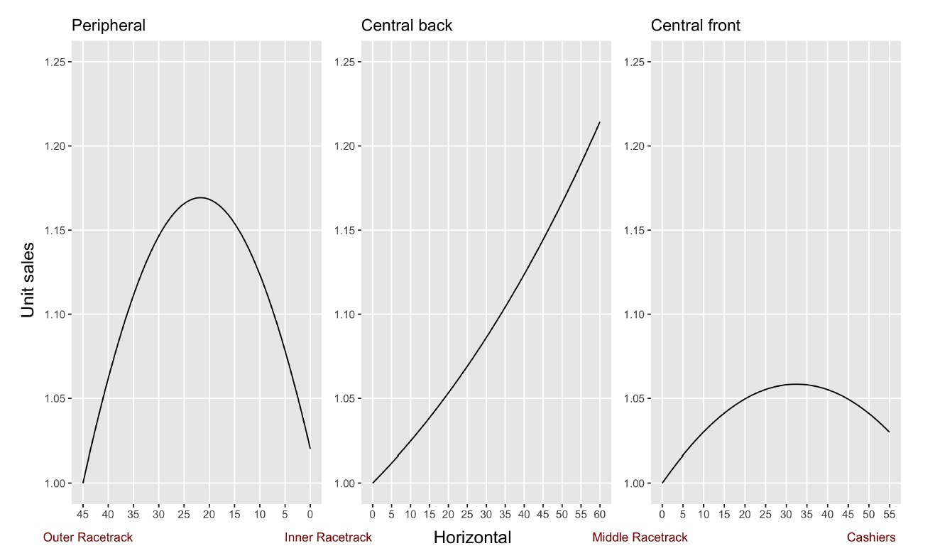
Sales and Horizontal Position
Unit Sales
Outer Racetrack Inner Racetrack Middle Track Cashiers
Horizontal Position

Slide 23
Quasi-experimental analysis
Motivation:
  Strategic allocation of products to shelf positions affects our estimates.
General idea: Quasi-experiment
  Identify products with sharp position changes in one store and use other stores as controls.
  We use an optimal change-point detection algorithm (Killick et al. 2012, JASA).

Slide 24
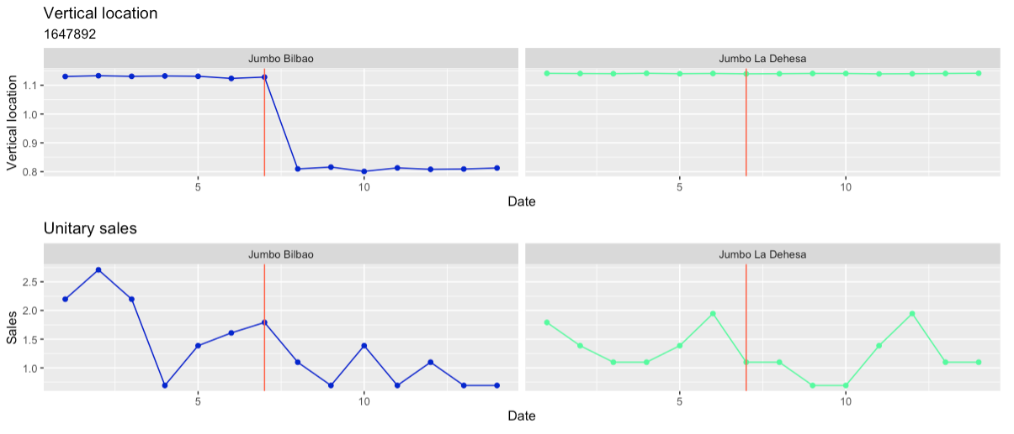
Quasi-experimental method
TREATMENT
CONTROL
Store A
Store B
Store A
Store B
Notes:
This plot shows the vertical position of a product on the shelf over time.
We see that on day 8, the vertical position drops by approximately 30 centimeters or 12 inches.
The plot on the right shows the same product but in another store, where its vertical position remained constant.
We can consider this product in Store A as the treatment product, and the same product in store B as a control product.
Our approach is based on identifying products like these, which experienced a change in their location in one store but not in another. And then compare their sales.
When identifying these products, we also verify that their prices did not change.

Slide 25
Identification and controls:
Change in sales could be due to:
  Seasonality -> day of the week and week fixed effects
  Price changes -> ruled out
  Different demand levels for each item across stores -> add store-item fixed effects
  Inventory changes -> exclude observations with stockouts
  Marketing campaigns -> control store helps with national campaigns, also relatively short windows of time before and after the position change

Slide 26
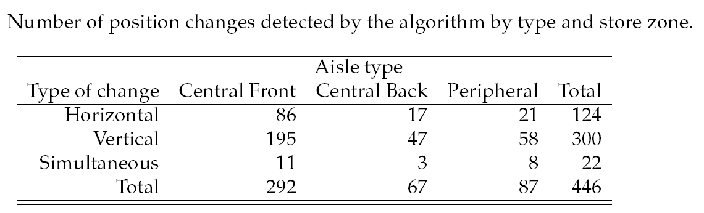
Quasi-experimental analysis
If we relied instead on field experiments, to obtain the same scope of analysis, one would need to convince a retailer to implement 446 experimental manipulations.

Slide 27
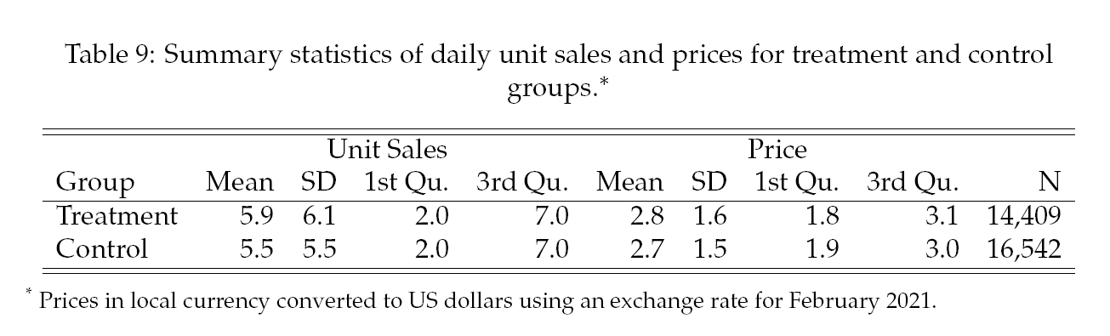
Quasi-experimental analysis

Slide 28
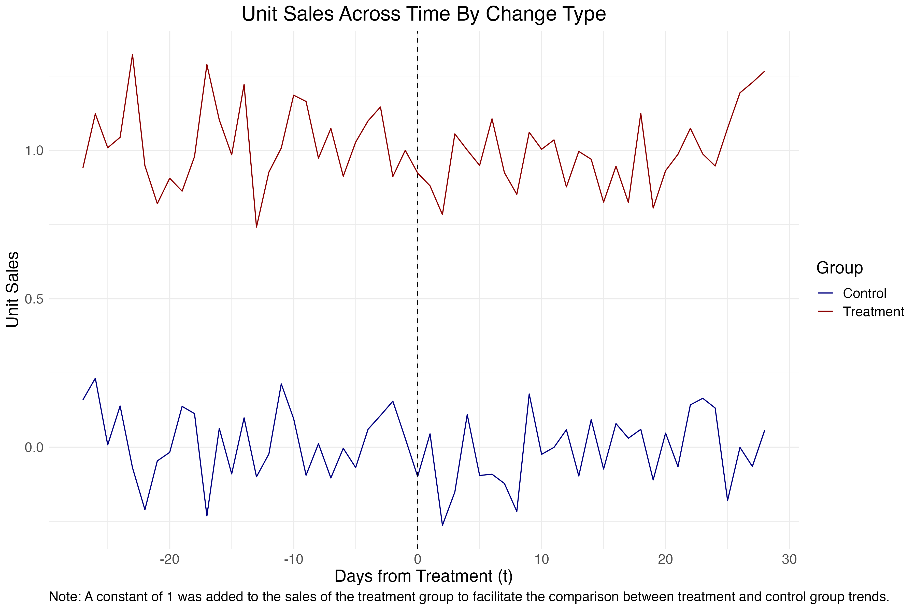
Parallel trends analysis

Slide 29
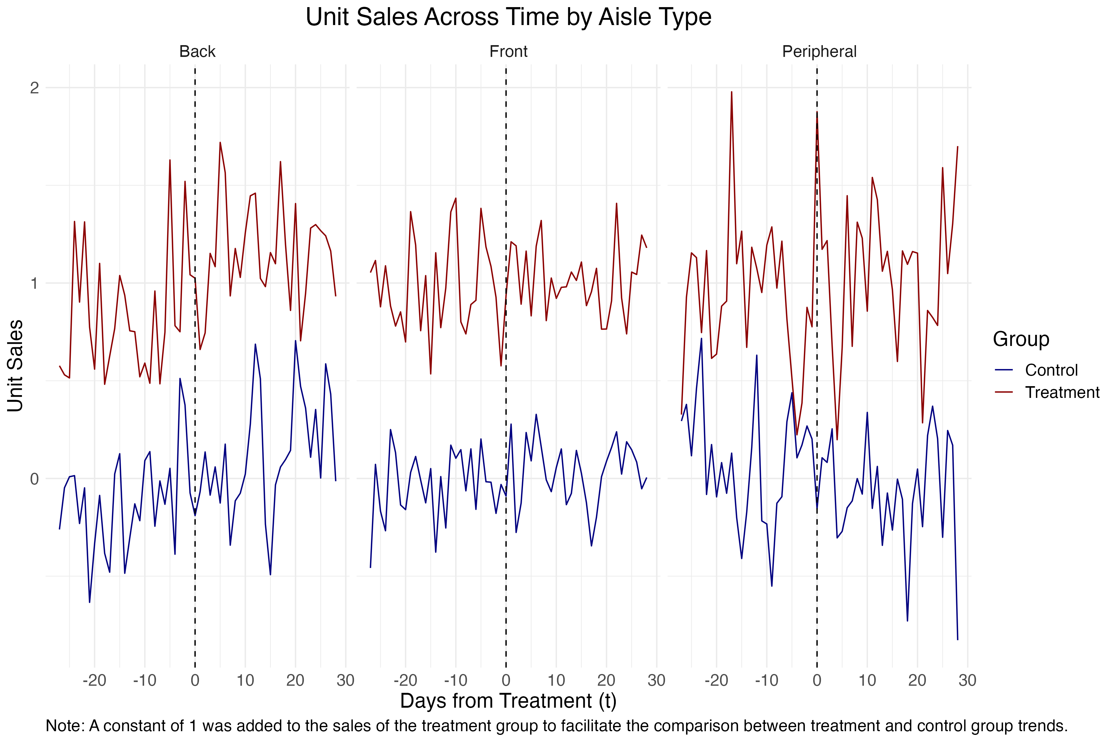
Parallel trends analysis

Slide 30
Empirical model
Dependent variable: sales_{ist}
Treatment:
  Position Changes:
    Vertical position
    Horizontal position
Controls: store, SKU, store*SKU, week, day of the week, treatment store, after periods.
Interactions: Aisle location within the store x Horizontal Shelf Position
period
product
store

Slide 31
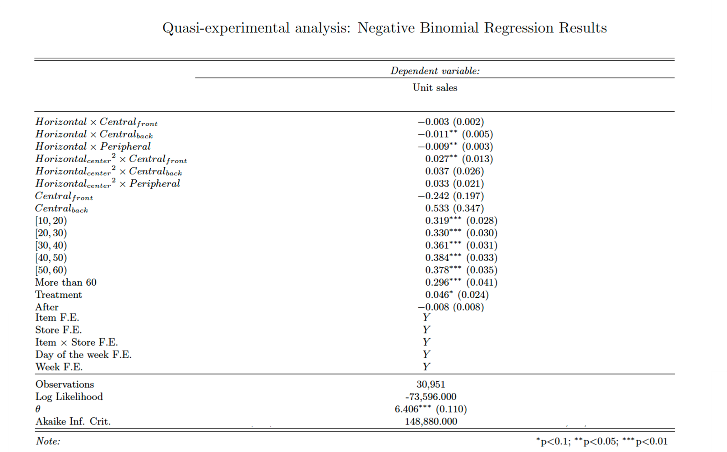

Slide 32
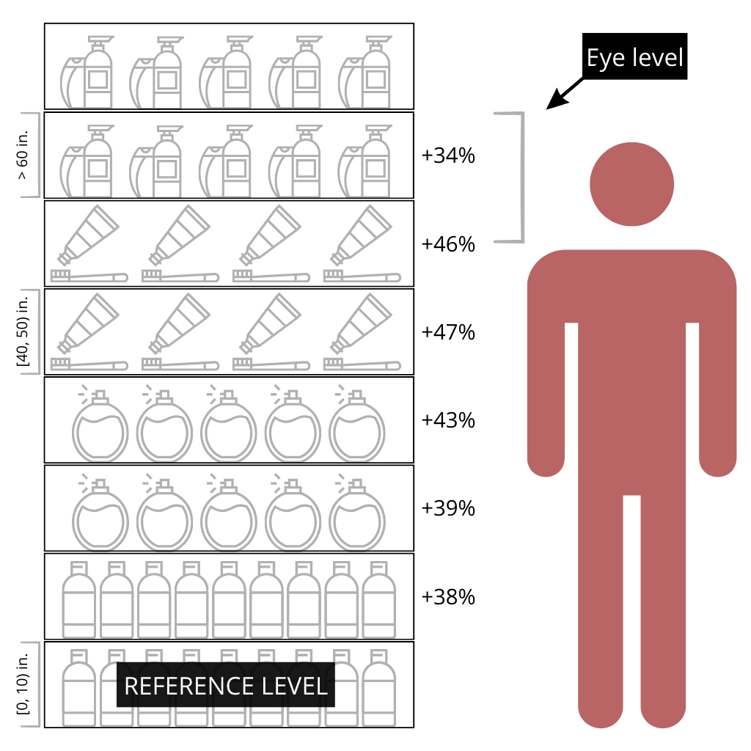
Effect of Vertical Position
1.02 - 1.27 meters
3.3’ – 4.2’
Notes:
Eye level between 57 and 70 inches
***
US
Standing Height B 60.2” – 68.4” 64.8” – 73.5”
Standing Eye Height C 56.9” – 65.0” 61.4” – 69.8” => average between 56.9 and 69.8 = 63.4
Chileans are 2 inches shorter
https://ehs.oregonstate.edu/sites/ehs.oregonstate.edu/files/pdf/ergo/ergonomicsanddesignreferenceguidewhitepaper.pdf
Page 7
************
https://www.cdc.gov/nchs/fastats/body-measurements.htm (Accessed feb 9 2024, 5:01pm eastern)
Men:
Height in inches: 69.0
Women:
Height in inches: 63.5
***
https://worldpopulationreview.com/country-rankings/average-height-by-country
Chile:
Male: 5 ft. 8 in.: 68in
Female: 5 ft. 3 in.: 63in
US:

Slide 33
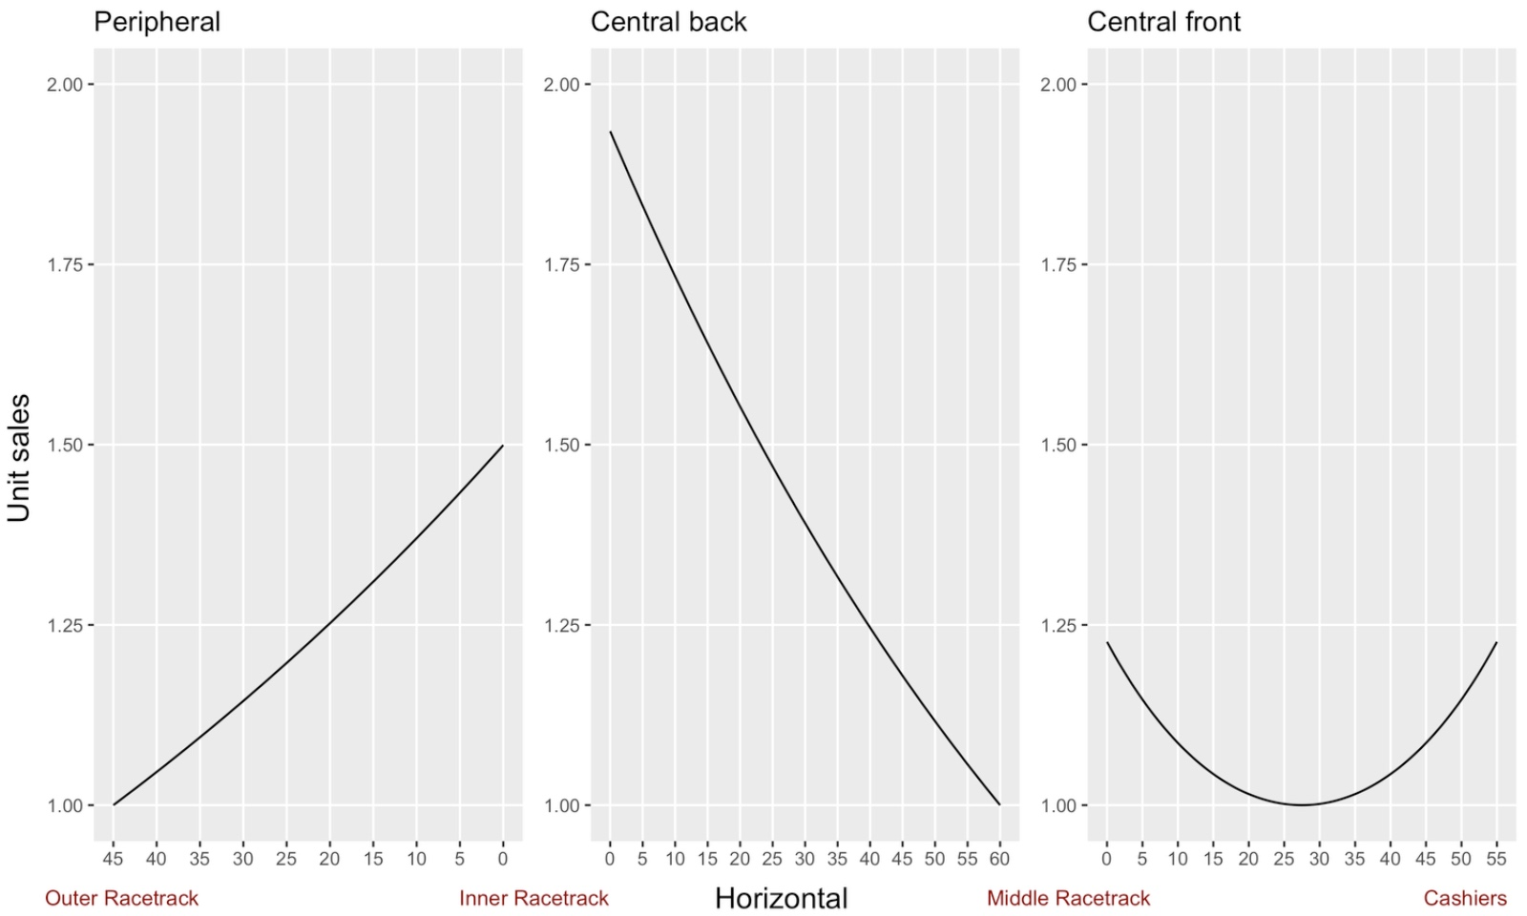
Sales and Horizontal Position
Unit Sales
Outer Racetrack Inner Racetrack Middle Track Cashiers
Horizontal Position

Slide 34
Support for hypotheses
Y
N
Y
N
Y, Racetrack end of aisle > Middle
Central Front
Y
H1 - Vertical Center: Products placed at heights right below the eye level achieve greater sales than if they were placed at other heights.
H2 - Bottom versus top vertical positions: For shelves of a typical height (i.e., at least 2 meters or 6.5 feet), products placed on the highest shelf achieve lower sales than if they were placed on the lowest shelf.
H3 - Horizontal position: Products placed near the racetrack will achieve greater sales.
H4a - Horizontal position: Products placed in the middle of an aisle will achieve greater sales than those near the ends of an aisle.
H4b - Horizontal position: Products placed in the middle of an aisle will not achieve greater sales than those near the ends of an aisle.
H5 - Vertical vs. horizontal position effects: The impact of vertical position on the sales of a product is expected to be stronger than that of horizontal position.
H6 - Endogeneity: Ignoring the strategic assignment of products to shelf positions would bias the value of certain shelf positions.

Slide 35
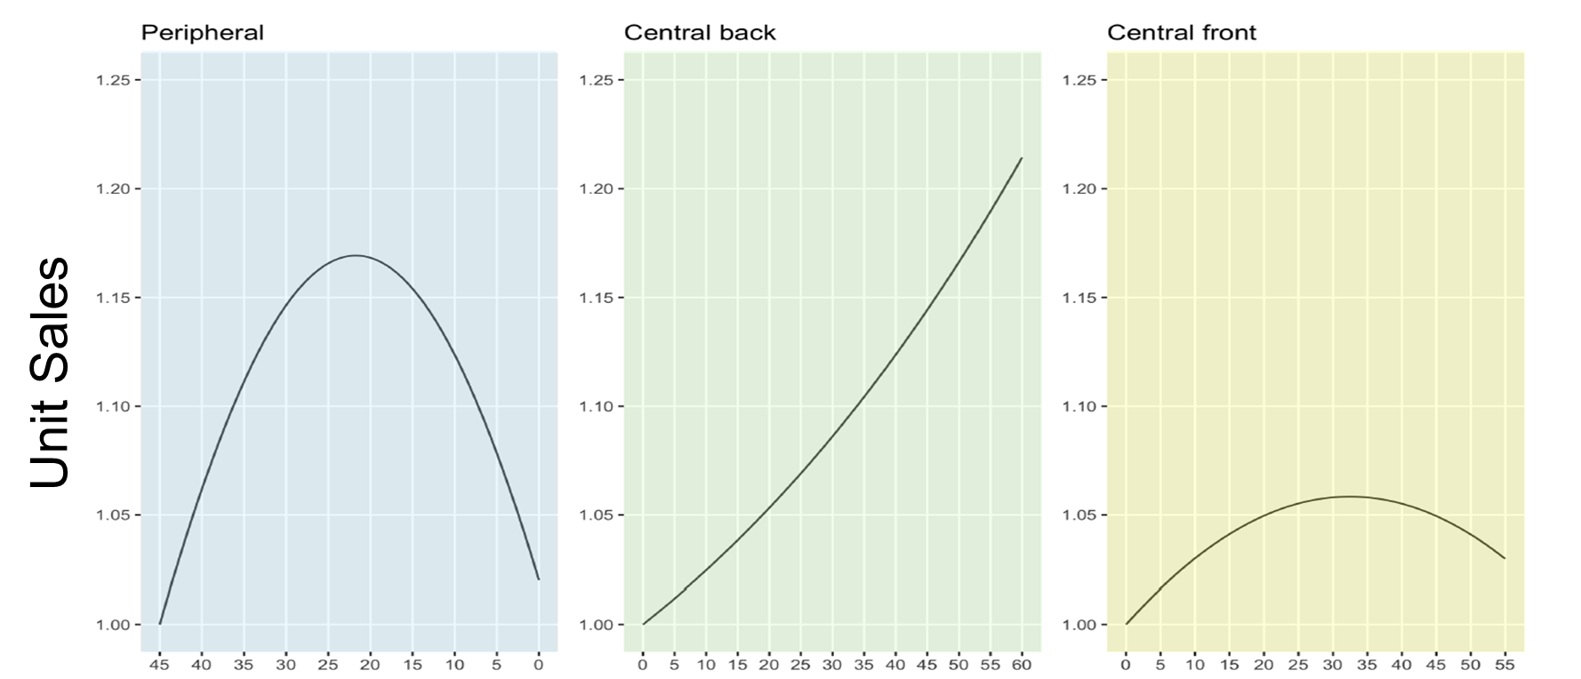
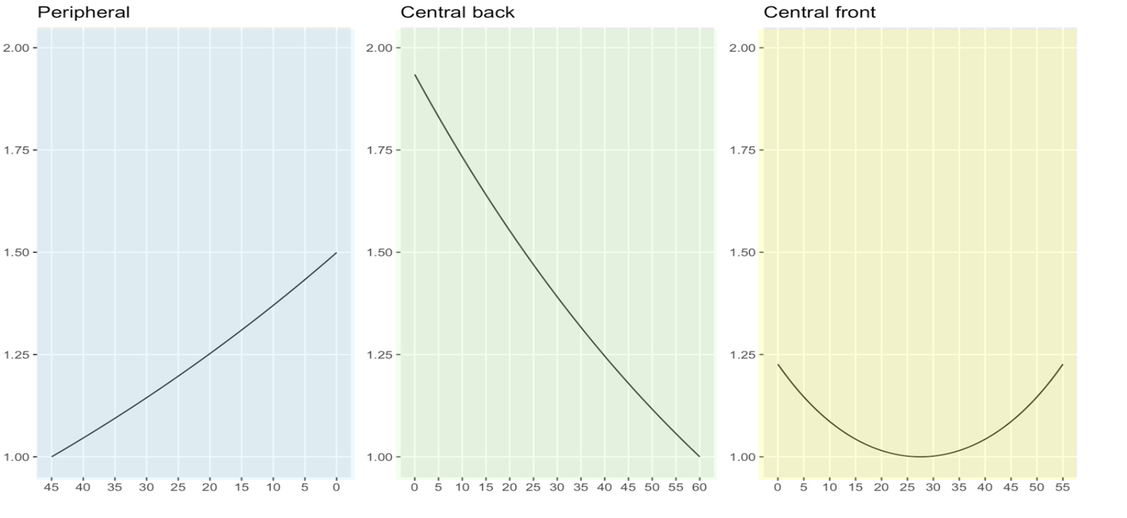
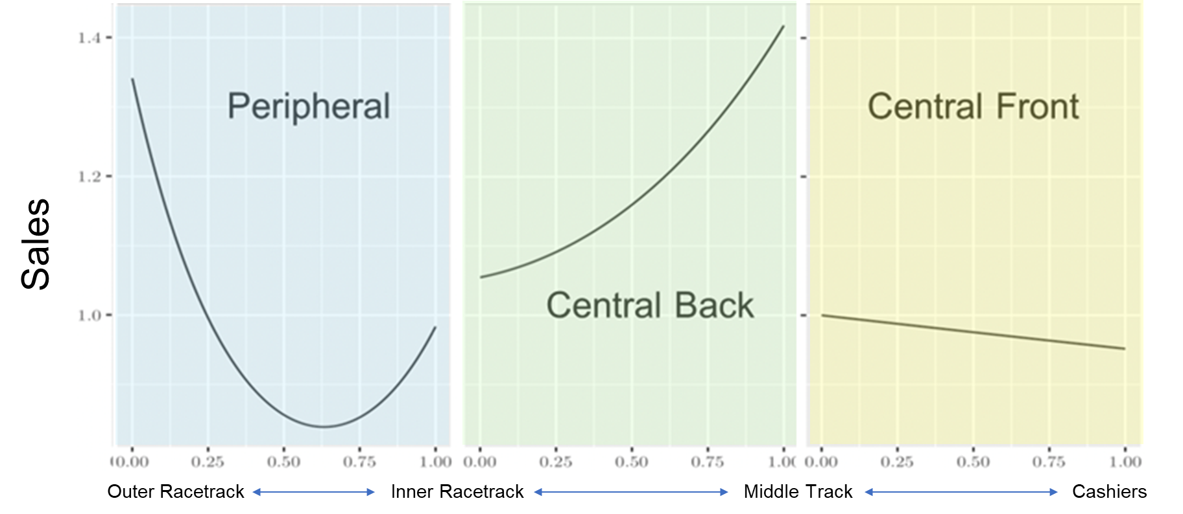
Descriptive vs. Causal Insights
Conclusions change when moving from descriptive to causal analysis:
  Vertical position: higher shelves no longer associated with lowest sales
  Horizontal position: very different results for all store zones.
Descriptive Causal

Slide 36
Conclusions
Retailers would benefit from a better understanding of the impact of product position on sales.
New technologies such as robotics and IoT are making it feasible to collect data on product position.
An experimental approach with a similar scope would require a retailer to agree to perform 446 experimental manipulations.
The results from this research suggest:
  It’s important to use a causal approach.
  Positions right below eye level lead to greater sales.
  Racetrack matters but requires a new interpretation for large stores (hipermarkets) -> middle track may also becomes important.
Notes:
Poner también después de explicar los resultados del análisis descriptivo.

Slide 37
Robotics, IoT And Point Of Sales Data To Measure The Impact Of
Shelf Position On Sales
Andrés Musalem
Sofía Pontigo
Ariel Schilkrut
University of Chile
Zippedi

